Slide 1

Basic Python scripting

Slide 2
Understanding Data Types
There are 5 basic data types in Python
Textual
Strings
Numerical
Integer (int), floating point (floats), complex numbers
Booleans
True/False
Notes:
These are scaler types, meaning, single elements.
Note: The operations that can be done on the data depends on the data type (e.g. addition (*) works different on strings, then they do on numerical types)

Slide 3
Understanding Data Structures
Available through Python’s Standard Library
Lists
Dictionaries
my_list = [item1, item2, item3]
my_dict = {"key1": item1, "key2": item2, ... }
my_dict = {"ppID": 1,
"sensor": "Sensor",
"data": [14, 47, 41, 6, 35, 12, 27, 48, 0, 25, 11, 36, 26, 28, 32]}
Notes:
A way of organizing and storing grouped pieces of data in python. Usually these pieces of data have a relationship with each other. This is also the way to store data in a certain order (e.g. time series data). Here lists and dictionaries are shown. Lists and dictionaries are part of the standard python library and form the basis of the python language.
Lists: my_list = [item1, item2, item3]
Can store any data type you'd want and can even combine them in a list
List output looks like an array [1, "hello", 2.2]
They can be modified and added onto when needed: my_list.append(item4)
Items can also easily be removed: my_list.remove(item2)
Dictionaries:
my_dict = {"key1": item1, "key2": item2, ... }
A dictionary contains a key, which is a string, with an associated item. This item can be whatever, a scalar, a list or other dictionary:
my_dict = {"ppID": 1, "sensor": "Sensor", "data": [14, 47, 41, 6, 35, 12, 27, 48, 0, 25, 11, 36, 26, 28, 32]}
It is very easy to index into dictionaries and explore its content:
To get the keys: my_dict.keys()
To get the content of a key: my_dict["data"]
To get a specific value of my data: my_dict["data"][4]
Indexing starts from 0

Slide 4
Python Loops and conditional statements
For loop and while
Loops and conditional statements
There are a few things that are important when considering loops, statement (and also functions, but more on that later).
The first line always end with a colon ( : ). If the colon is missing you get a SyntaxError:
Indentation of the following lines are important. Either a tab of 4 spaces. Otherwise, you get an IndentationError:
If the colon is placed correctly, indentation should be automatic.
Contrary to MATLAB programming, a loop, conditional statement (or function) do not end with an end statement.
the end is indicated with a black line and a reset of the indentation

Slide 5
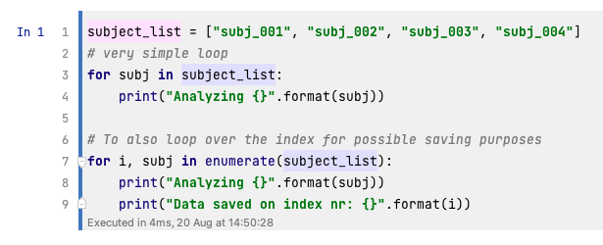
Examples
For loops

Slide 6
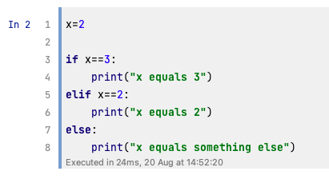
Examples
If statements

Slide 7
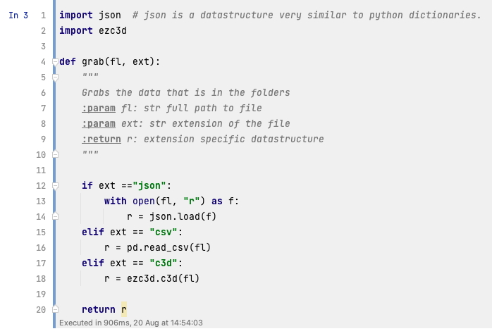
Python functions
Function inputs and function outputs

Slide 8
Debugging
Play computer and fix the issue
Notes:
Debugging can be a hassle in Python. Here in Jupyter Notebook, there is no debugging button you can click. The advantage of Jupyter notebook or Google Colab is that you can run cell by cell to see where you are going wrong. But it is harder to debug functions that way, as you cannot step into the function to see what happens. In those cases small and simple IDEs like Thonny can come in handy. Copy past your code, and visually see what happens. When using IDEs like PyCharm, DataSpell, ect, there is a debugging button. Just set a break point where you need it and run your script by pressing the bug icon. Then you can step into the code and see what is happening and find the error.

Slide 9
Overview of content so far

